Slide 1
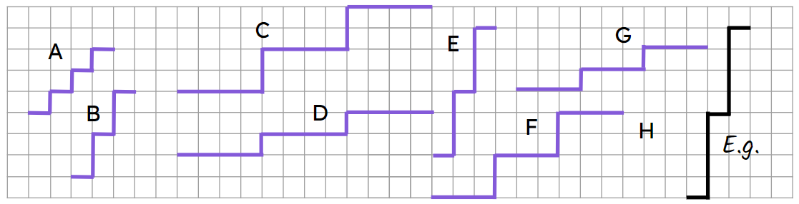
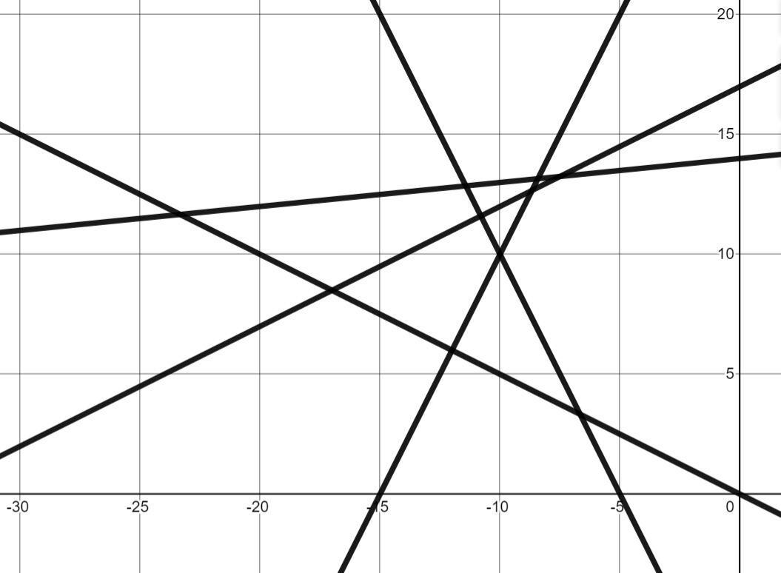
Positive rate of change from a graph
Task A: Defining gradient
1)
a) Put these steps in order from steepest to gentlest.
steepest: E - B - A - F - C - G - D gentlest
b) Draw staircase H so it is the steepest staircase.
c) Another set of steps join point P to point Q. Where would these steps go in order of steepness?
× Q
Same as A
× P
2) Which lines have a positive gradient?
3) Which tables of values show a relationship which will have positive gradient when plotted?
C
D
E
a)
b)
c)
x | 0 | 1 | 2 | 3
y | 3 | 5 | 7 | 9
B
Positive, y increases as x increases
A
x | −2 | −1 | 0 | 1
y | 12 | 8 | 4 | 0
A, B and E have positive gradients
Not positive, y decreases as x increases
x | −8 | −7 | −6 | −5
y | −8 | −5 | −2 | 1
Positive, y increases as x increases

Slide 2
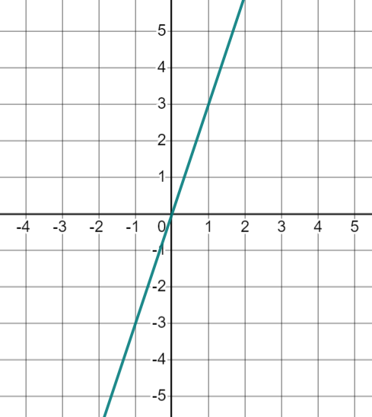
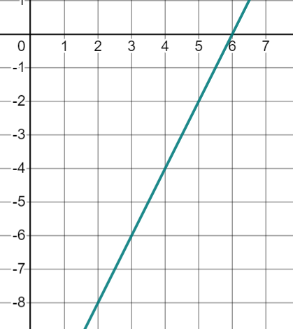
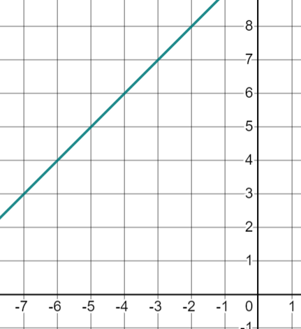
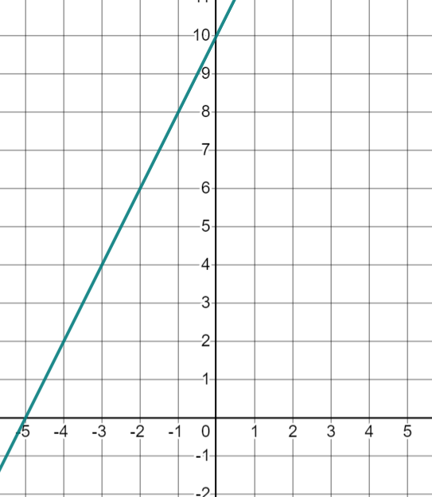
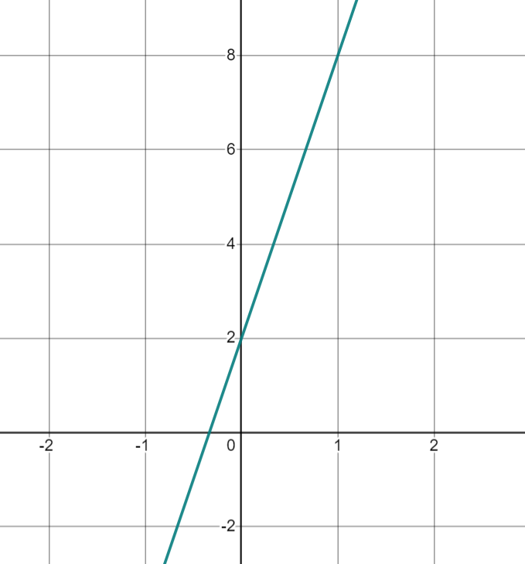
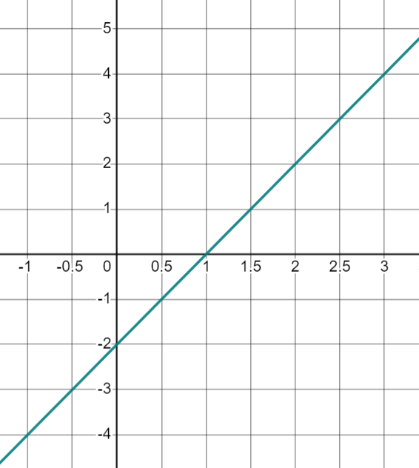
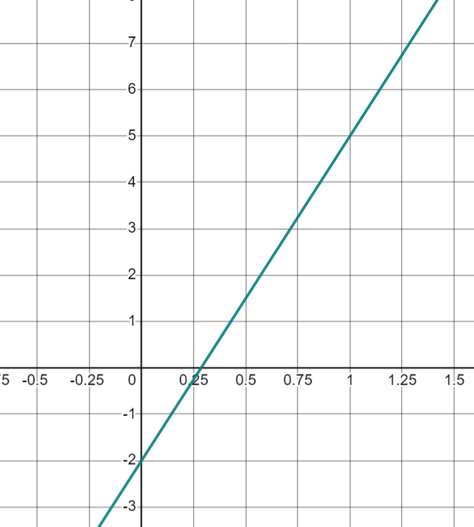
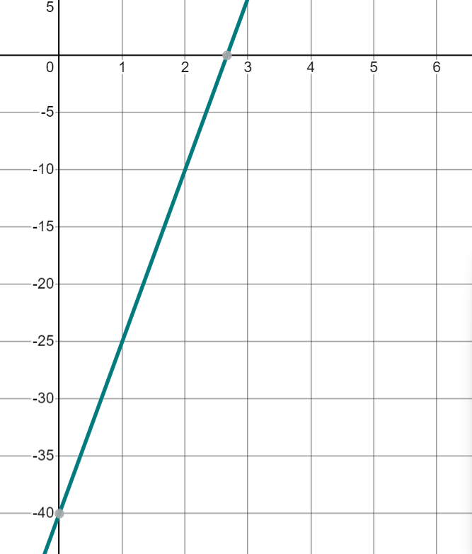
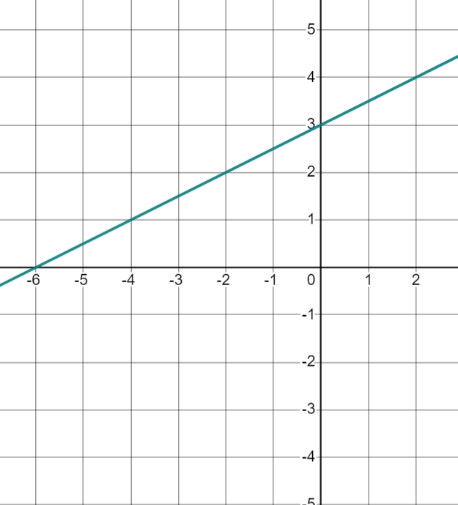
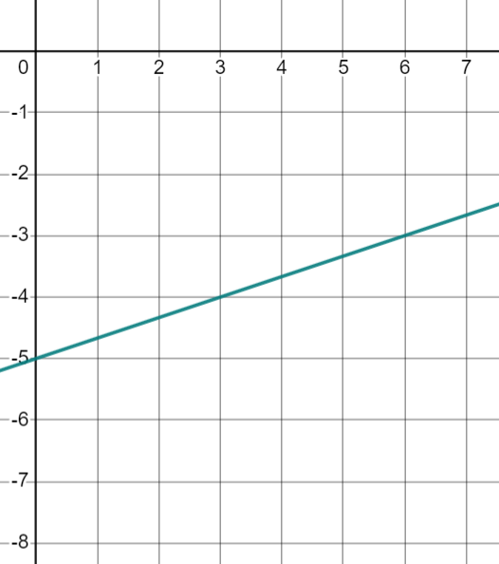
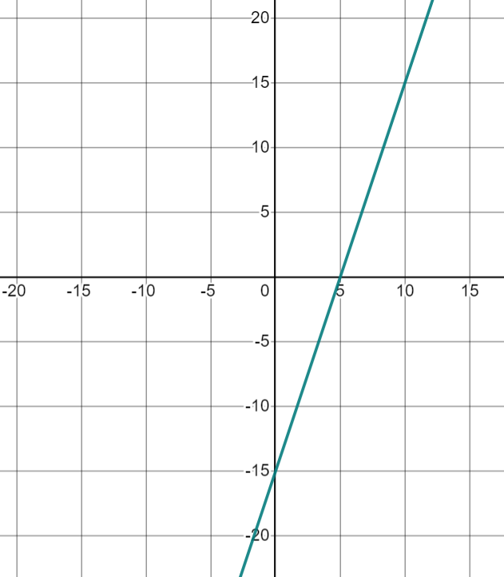
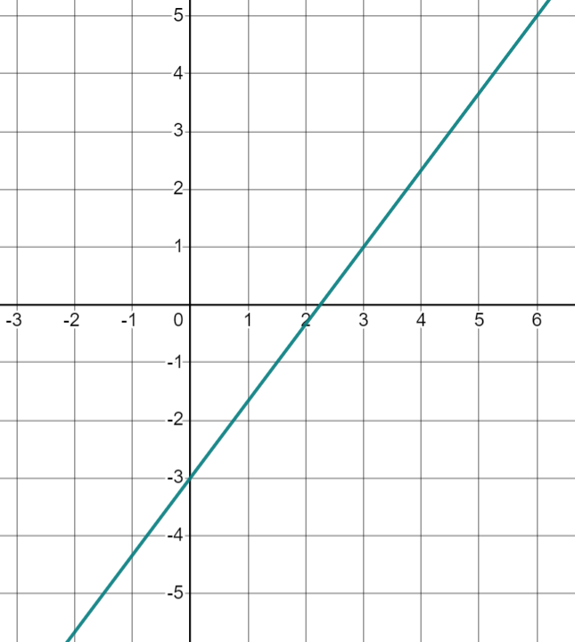



Positive rate of change from a graph
Task B: Calculating positive gradients from graphs
1) Find the gradient of each line. You can draw a ratio table to help you.
a) | b) | c) | d)
3
2
1
2
e) | f)
g) | h)
6
2
7
15
i) | j) | k) | l)
2 | 1
1
3 | 1
1
5 | 15
1 | 3
3 | 4
1
Mathematics in Education and Industry
v2.2

